Slide 1

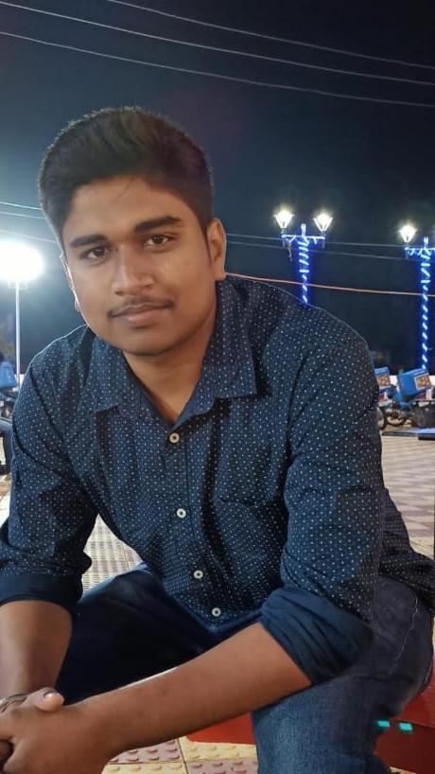


Ashutosh Singh
Education and certificates
Bachelor of Technology Information Technology : 2016 - 2020
Analyst/Software Engineer
Skills
Mule4 Agile Development XML, Json Cloud deployment
Base Location: ^{Bangalore}
Email ID:
Ashutosh.k.singh@capgemini.com
_{Mobile No:} +91 7008893778
Grade:
A4
Backend
RAML
Pgsql-DB
REST-API, Dataweave 2.0, Active MQ, Scheduler
Competencies
•Have thorough understanding of Integration Principles and Design Patterns.
• Ability to comprehend the Business Requirement, Design and proficient in using Anypoint Platform to discover, consume, build, deploy, manage, and govern APIs.
• Ability to use Anypoint Studio to build, deploy and test APIs.
• Well versed with MuleSoft Integration Best Practices.
• Well versed in Agile Methodology and working within Scrum Framework.
•Hands on experience in building API-led and Connector-based integrations for end points like Files, Database etc.
• Analytical mindset and problem solving skills.
• Good communication skills and effective team player.
Integration Experience
Hotel Management System Application
Worked for a Retail client to create RAMLs and made it modular using Traits, Library and Fragments
Database
SQL database – MySQL
Pg-Sql
Implemented Banking Accelerator includes creating RAMLs, build Mule APIs and writing MUnits.
Used Dataweave transformations to handle diverse set of message formats like JSON, XML, CSV, etc. and have worked on various operators like map, pluck, Arrays, lookup and modules.
Web Technologies
HTML5 CSS3
Working knowledge of batch implementations, to synchronise data between Salesforce and business database.
AddOns Github Maven Postman
Created CI pipeline in Jenkins to clone the source code from Git, execute MUnits and deployment on CloudHub.
Additional Details
Excellent Communication Skills
Team Player
Presentation Title | Author | Date © Capgemini 2017. All rights reserved | 1

